Slide 1

THE PROFIT PILLARS
Shopify’s Analytics: Data to Dollars
‘Stop feeling busy and start feeling profitable’
Learn to transform raw Shopify store data into tangible revenue and business growth through strategic analysis
Instructor : Hassarath, A.

Slide 2




Module 1: Mastering the Money Metrics
Deeper Understanding
Data Transformation
Smarter Decisions
Understanding the Profit Pillars (CR, AOV, CLV) to separate meaningful data from noise and secondary activity stats.
Learn to transform raw Shopify store data into tangible revenue and business growth through strategic analysis.
Utilize proven metrics to move beyond activity reporting to profitable, data-backed strategic actions.
Hassarath, A. (2025). Course Curriculum.
Notes:
This module introduces the Profit Pillars—Conversion Rate (CR), Average Order Value (AOV), and Customer Lifetime Value (CLV). These are the core "money metrics" that tell us whether a business is actually making money or simply generating activity. Understanding these metrics helps merchants separate meaningful data from noise. This course will provide a deeper understanding of these metrics and how to use them to transform raw data into actual money for a business. Ultimately, using these metrics helps businesses make smarter, more profitable decisions.

Slide 3



The Data-to-Action Gap
The Challenge
Merchants are often overwhelmed by overwhelming amounts of data—charts, graphs, or reports that lack context.
Too much data creates "analysis paralysis," leading to expensive mistakes and severe sales losses.
Solution: Money Metrics focus directly on revenue, driving clear business actions.
Hassarath, A. (2025). The Data-to-Action Gap: From Noise to Knowledge
Notes:
Google Gemini. (2026). Illustration of a merchant overwhelmed by data and information overload [AI-generated image].
Merchants often feel overwhelmed by the sheer amount of data available in dashboards, charts, and Shopify’s 3D globe. This "Data to Action" gap exists because too much data can create a lack of understanding. Thus, failing to understand data can lead to mistakes that cause severe sales losses. The Profit Pillars simplify everything by cutting through the noise and focusing only on the metrics that directly impact revenue. When merchants know exactly which metric is causing a problem, they know exactly what action to take.

Slide 4
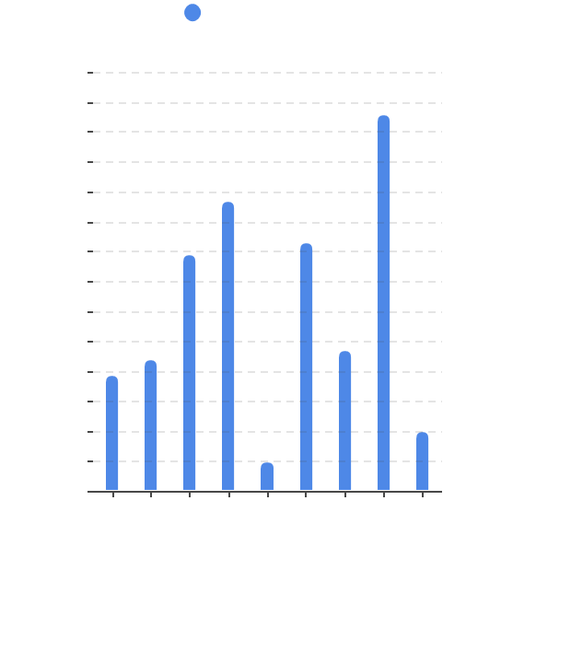


Pillar 1: Conversion Rate (CR)
The Effectiveness Metric
Measures how well a business can turn a website visitor into a paying customer.
Measure Store Effectiveness
Affects Return of Investment
7.0
6.0
5.0
4.0
1.4-3%
Page Load Improvement (100ms)
Market Median
Shopify. (2026, January 7). B2B conversion rate optimization: Strategies, benchmarks and examples (2026)
Notes:
Citations:
Napkin AI. (2026). Conversion rate bar chart [AI-generated image].
First, Conversion Rate. It is the measure of how well a business turns a website visitor into a paying customer. To calculate it, take your Total Conversions—the number of visitors who became customers—and divide that by the Total Visits to your website during that same period. This is the primary way we measure how effective your store actually is at selling.

Slide 5
Diagnosing Friction vs. Flow
Lower CR (Friction)
Higher CR (Flow)
Confusing design discourages visitors.
Every friction point wastes the expensive ad spend used to bring them in.
Strong, simple design facilitates a seamless purchase journey.
It is the "friction finder" for your UX.
Result: High Bounce & Lost ROI.
Result: Efficient Scaling & Growth.
Strategy: It’s often cheaper to fix your website than to buy more ads.
Fessenden, T. (2018). Conversion Rates & UX Friction.
Notes:
CR is one of the most powerful levers for generating revenue, often having a bigger impact than simply increasing traffic. It directly reflects how effectively your website's design, messaging, and user experience (UX) align with your audience's needs. Conversion rate is often called the “friction finder”. If it’s low, it usually means your design is too complex or your customers are confused. When it's high, it means you've built a bridge, not a wall. Boosting this is the fastest way to increase revenue without needing a single extra visitor."

Slide 6

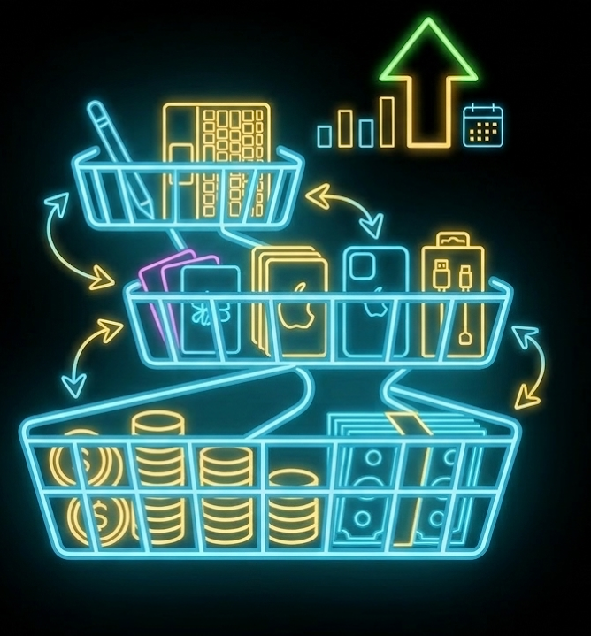


Pillar 2: Average Order Value (AOV)
The Basket Booster
Measures the average amount a customer spends per order.
AOV is the primary weapon against rising ad costs.
Often influenced by bundles, pricing, and upsells.
Increasing AOV earns more from the exact same amount of traffic.
Shopify. (2026, January 7). Average order value (AOV): Formula, benchmarks and 7 ways to increase it.
Notes:
Citations:
Google. (2026). Basket booster metric visualization [AI-generated image]. Gemini 3 Flash.
The second pillar is Average Order Value, or AOV. This measures the average amount a customer spends per order. Your pricing, the products you offer, and how you bundle them together all determine your AOV. It is a key metric because it helps you get the most out of your existing customer

Slide 7
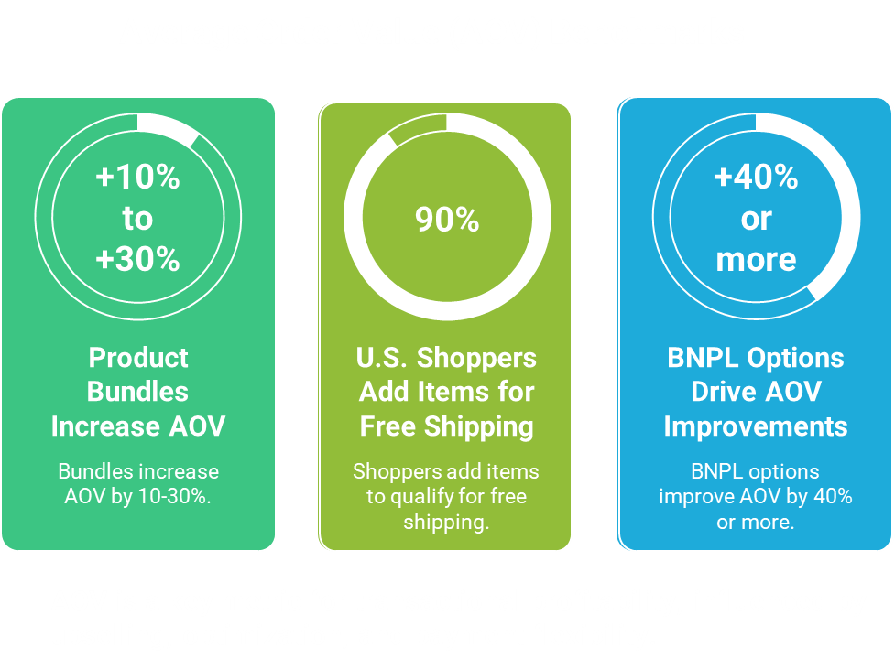
The Strategic Impact Of AOV
Product Bundles ( Upselling or Cross-Selling) make customers buy more items or expensive items
Free Shipping make customers buy more items
BNPL ( Buy More, Pay Later) increases price flexibility, which increases lower prices and increase customer spending.
Napkin AI. (2026). Average Order Value (AOV) Benchmarks infographic
Notes:
Citations:
Grooic. (2025, January 21). 3 key eCommerce metrics you must track: AOV, CR, and RPV.
Saras Analytics. (2025, July 10). AOV eCommerce: 11 strategies for driving higher sales in 2025.
Triple Whale. (n.d.). Ecommerce benchmarks 2025: Key metrics & industry data.
AOV is crucial for sustainability. As advertising costs continue to rise, a higher AOV helps you offset those costs. Simply put: higher AOV means more revenue per customer, which gives you more profit to reinvest back into the business for sustainable growth. ads are getting more expensive every year. If it costs you to get a customer, and they only spend , you’re in trouble. But if they spend , you’re winning. A high AOV is your insurance policy against rising marketing costs. To put it simply, these strategies are about getting customers to put more in their carts before they check out. Here is the breakdown: Product

Slide 8
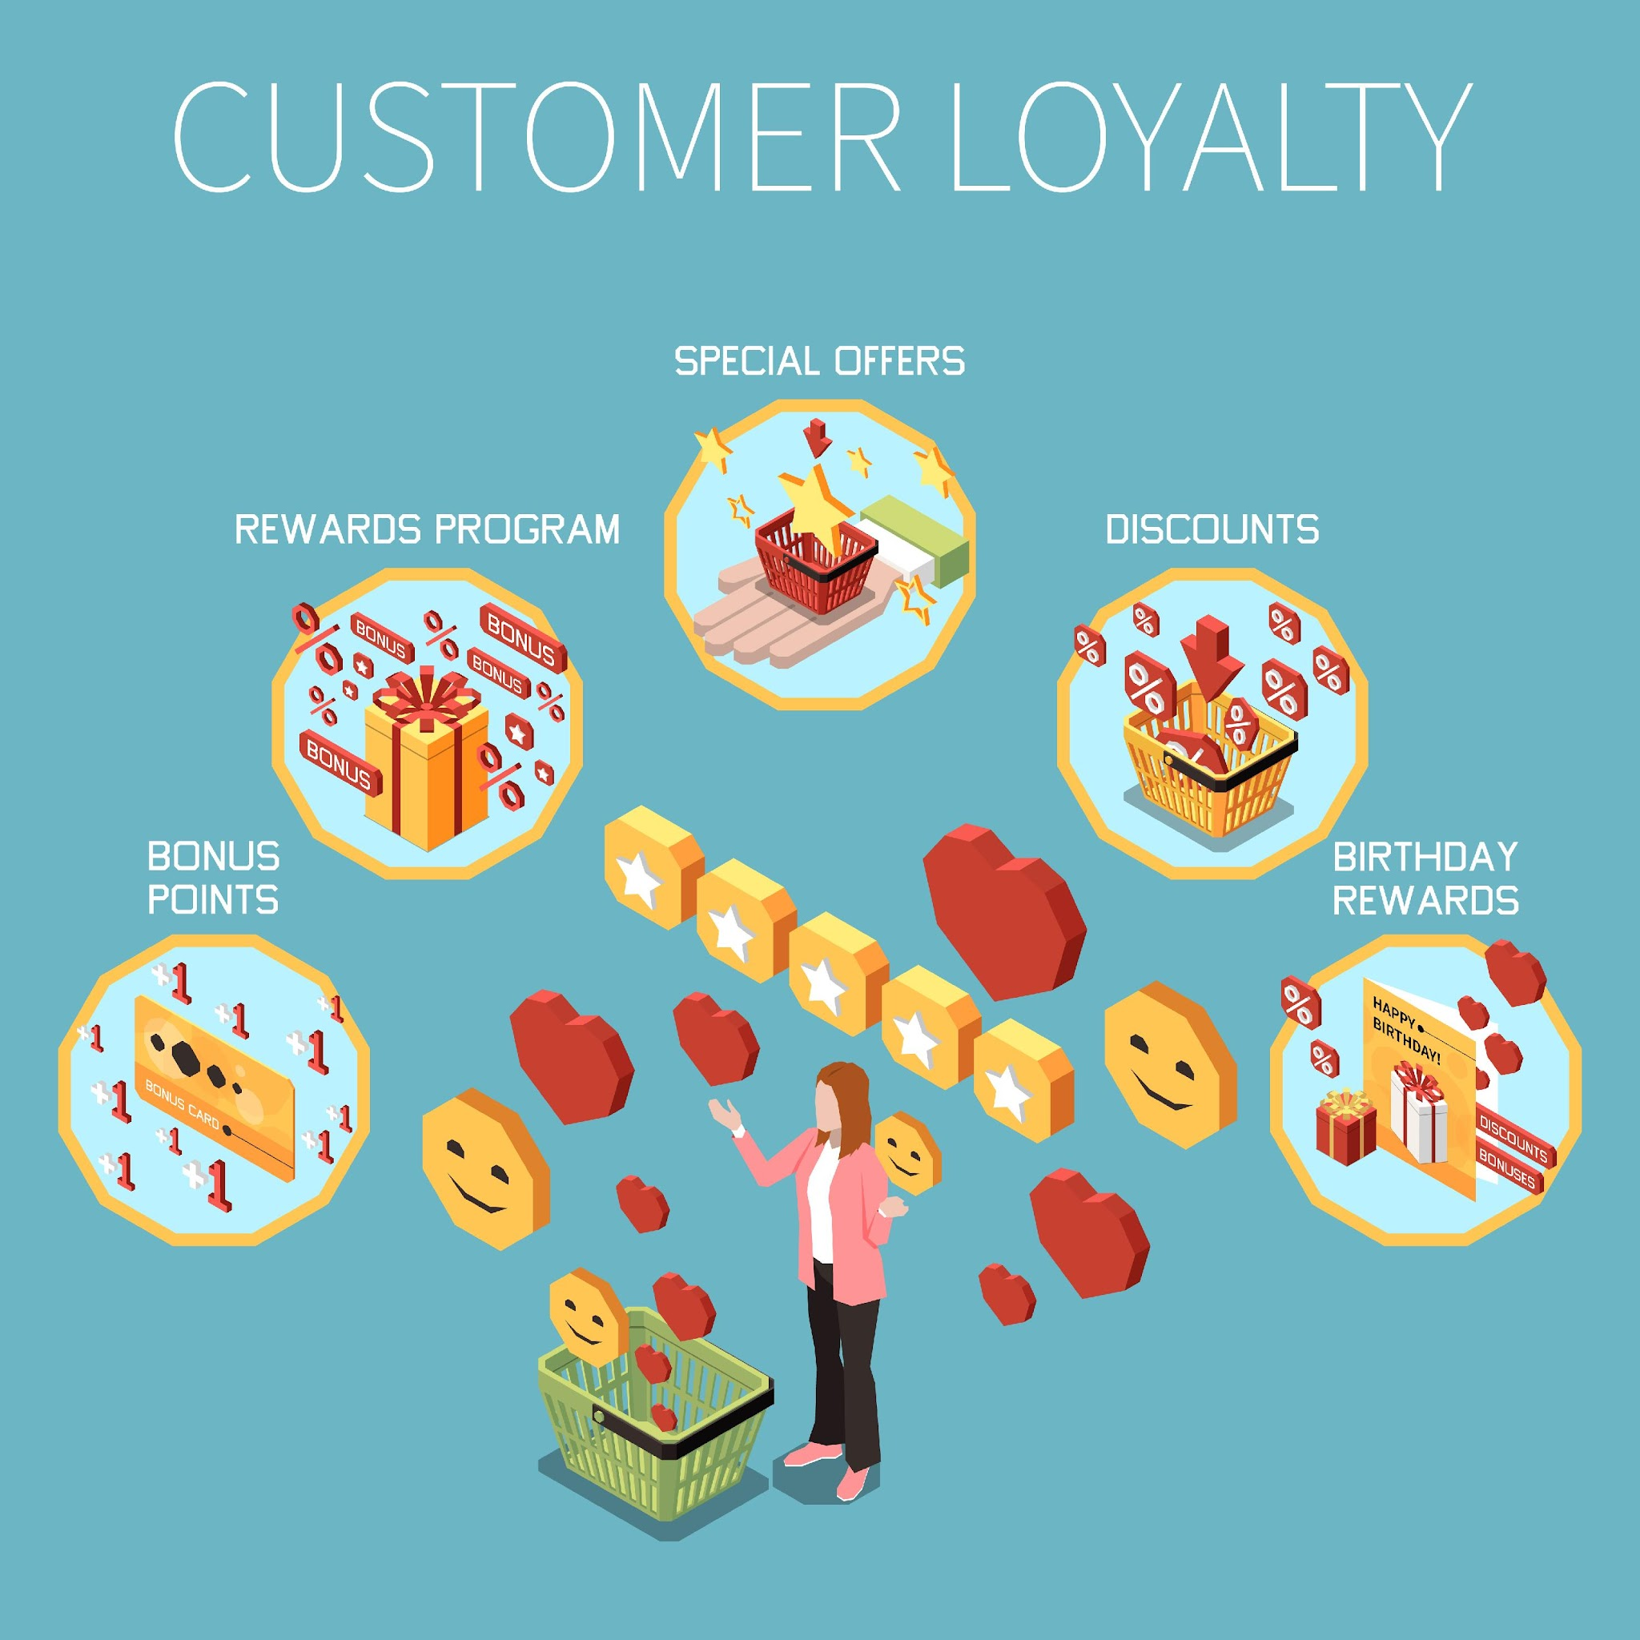
Pillar 3: Customer Lifetime Value
The Long Game
CLV is the total revenue expected from a customer over their entire shopping lifespan with your brand.
Predicts long-term profitability and drives retention strategy.
Shift focus from "The Sale" to "The Relationship."
Retaining a customer is 5x cheaper than acquiring a new one.
Valadez, A. (2025, April 4). How to calculate customer lifetime value (CLV) & why it matters.
.
Notes:
Citation:
Image: Macrovector. (n.d.). Customer loyalty isometric infographic [Vector image]. Freepik.
The third pillar is Customer Lifetime Value. This is the total revenue you expect to receive from a customer over the entire time they shop with you. While CR and AOV look at the immediate sale, CLV looks at long-term profitability. It is the ultimate metric for understanding how well you are retaining your customers.

Slide 9
Why CLV Matters
Marketing Budgets: CLV guides exactly how much you can afford to spend on acquisition (Customer Acquisition Cost).
If a customer is worth $400 over a year, you can outbid competitors.
Segmentation: Helps identify the high-value segments that deserve special treatment and unique rewards.
Business Stability: Supports long-term planning and loyalty.
A 5% increase in retention can boost total profits by 25% to 95%.
Bain & Company (2023). Value of Loyalty.
Notes:
CLV matters because it tells you how much you can afford to spend to get a customer in the first place. It helps you identify your most valuable customers so you can focus your efforts on keeping them. A strong focus on CLV builds merchant retention and loyalty, leading to faster achievements over time. CLV is the ultimate reward for great products and even better service.

Slide 10
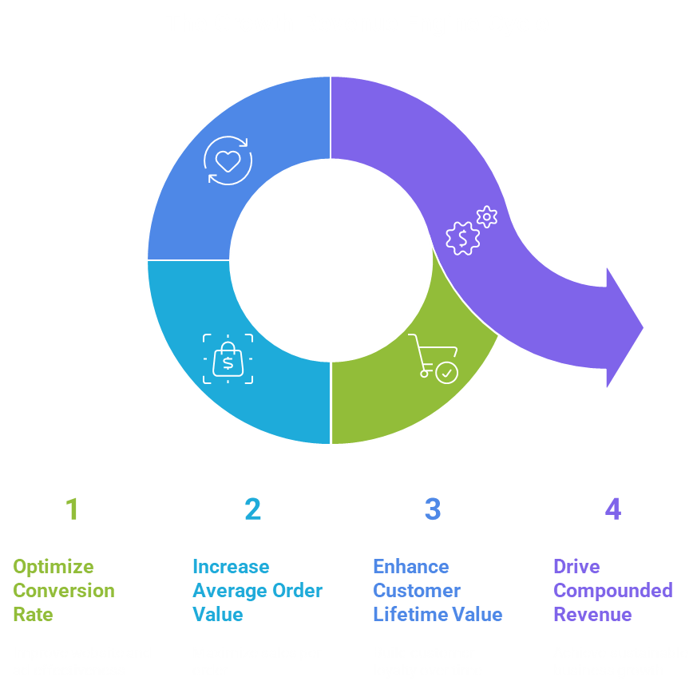
CR × AOV × CLV = Compounded Revenue Engine
IronLinx (2021). Synergy Models.
Notes:
Citations:
Napkin AI. (2026). The Growth Revenue Engine Cycle infographic [AI-generated image].
These three aren't just independent stats; they are an engine. If you improve your CR, your ads work better. If you raise your AOV, your profit grows. If you boost CLV, your business becomes stable. When all three are working together, you aren't just running a shop; you're engineering a growth machine."

Slide 11
Diagnosing the Metrics
Low
Conversion
Rate
Low Customer
Lifetime Value
Low Average
Order Value
Build loyalty through
post-purchase
emails, loyalty
programs, and VIP
support.
Improve offers with
product bundles,
upsells, or tiered
shipping.
Focus on simplifying
design, improving
mobile response, and
clarifying USP to
encourage checkout.
"Listen to what the data is telling you—it's the only way to find the signal in the noise."
Hassarath, A. (2025). Diagnosing Data.
Notes:
Citation:
Napkin AI. (2026). Which money metric needs improvement? infographic [AI-generated image]
So, where do you start? If you have plenty of traffic but no sales, fix your CR. If you have sales but no profit, raise your AOV. If you’re struggling to keep the lights on month-to-month, you need to work on your CLV. The data is talking to you—you just have to know how to listen and drown out the noise.

Slide 12
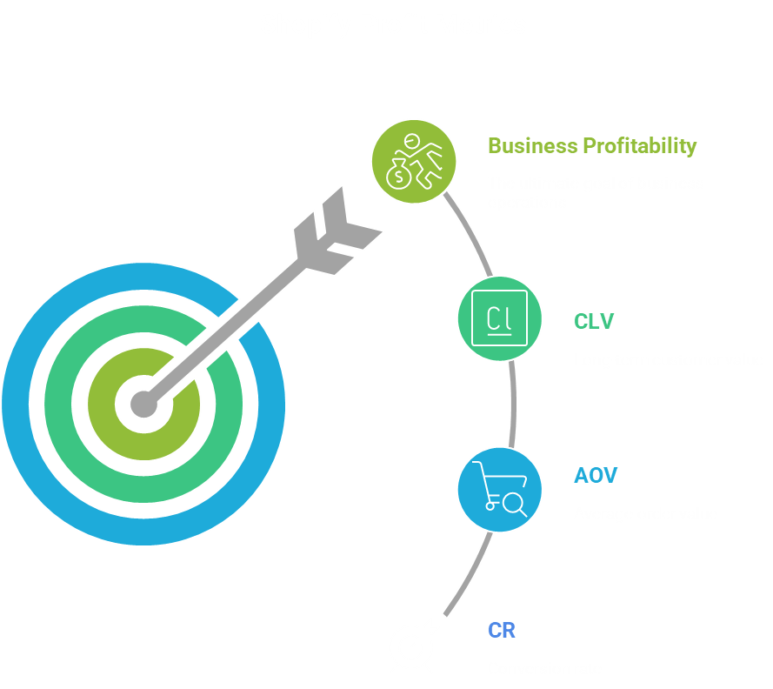
Module Summary
CR = effectiveness → Are my business’s websites or ads effective?
AOV = value per order → How do I maximize the sales for my business?
CLV = value over time → Does my business have a future?
Together → business profitability
Stop feeling 'busy' and start feeling 'profitable.'
Hassarath, A. (2025). Shopify’s Analytics: Data to Dollars.
Notes:
Citation-
Napkin AI. (2026). Business profitability and metrics target infographic [AI-generated image]
To wrap things up: CR is your effectiveness, AOV is for value, and CLV is your longevity. If you master these three, you’ll stop feeling 'busy' and start feeling 'profitable.’

